Slide 1
Applied linear regression
蒋智超
2025年 秋

Slide 2
Main topics
Linear models
Generalized linear models
For each model, we focus on
Model formulation
Interpretation
Point estimation
Statistical inference
Prediction
Model checking and selection
Implementation in R

Slide 3
Linear models
We study linear models with different sets of assumptions
Purely algebraic linear model
Heteroskedastic linear model
Gauss-Markov model
Generalized Gauss-Markov model
Normal linear model
We use the OLS as the common estimator across these models
This part is organized around the properties of the OLS under different models

Slide 4
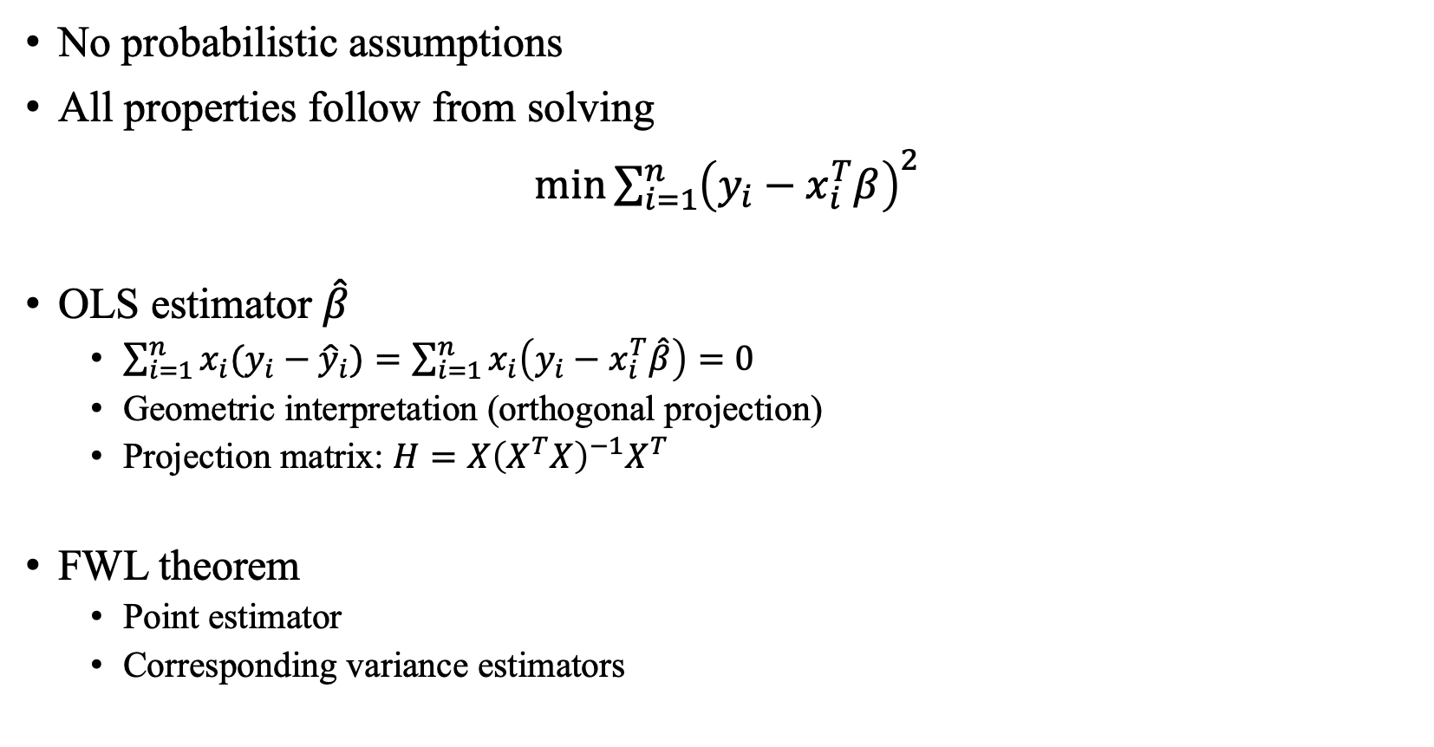
Algebraic properties of OLS
No probabilistic assumptions
All properties follow from solving
$\min{\sum_{i=1}^{n}{{\left(y_{i}−x_{i}^{T}β\right)}^{2}}}$
OLS estimator $\hat{β}$
$\sum_{i=1}^{n}{x_{i}(y_{i}−{\hat{y}}_{i})}=\sum_{i=1}^{n}{x_{i}\left(y_{i}−x_{i}^{T}\hat{β}\right)=0}$
Geometric interpretation (orthogonal projection)
Projection matrix: $H=X{\left(X^{T}X\right)}^{−1}X^{T}$
FWL theorem
Point estimator
Corresponding variance estimators

Slide 5
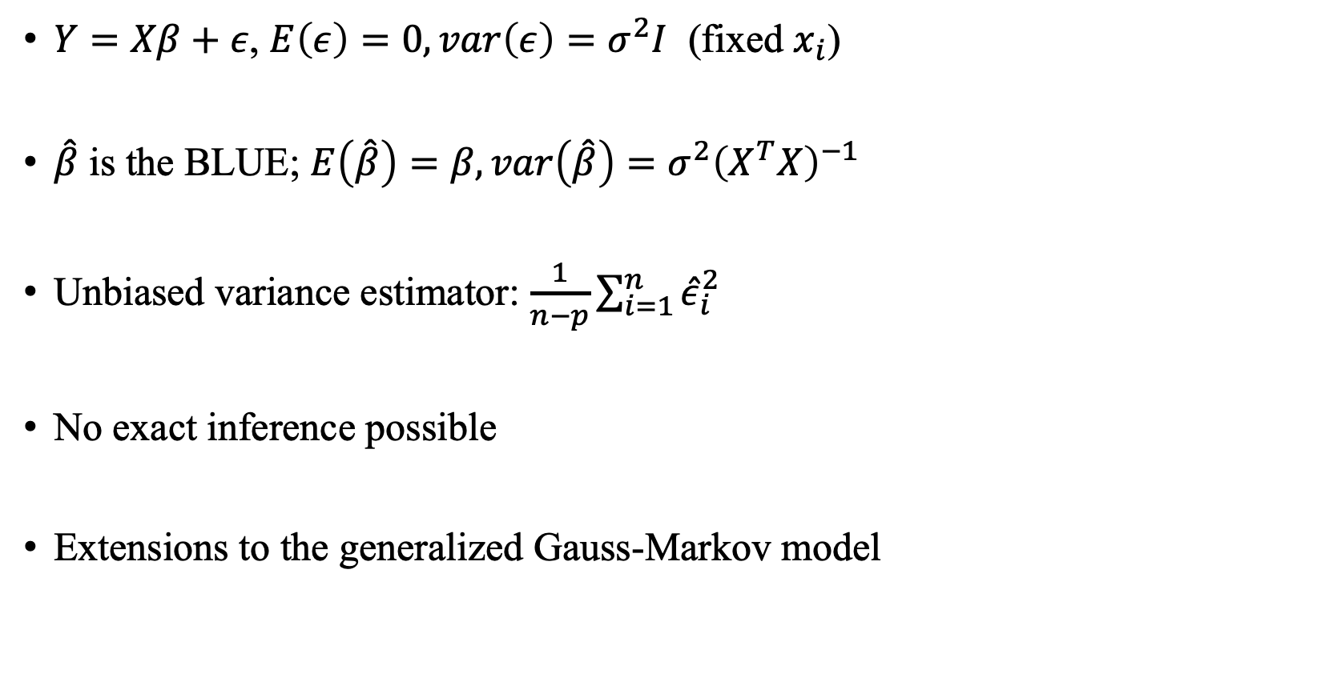
Statistical properties under Gauss-Markov model
$Y=Xβ+ε$, $E\left(ε\right)=0, var\left(ε\right)=σ^{2}I$ (fixed $x_{i}$)
$\hat{β}$ is the BLUE; $E\left(\hat{β}\right)=β, var\left(\hat{β}\right)=σ^{2}{\left(X^{T}X\right)}^{−1}$
Unbiased variance estimator: $\frac{1}{n−p}\sum_{i=1}^{n}{{\hat{ε}}_{i}^{2}}$
No exact inference possible
Extensions to the generalized Gauss-Markov model

Slide 6
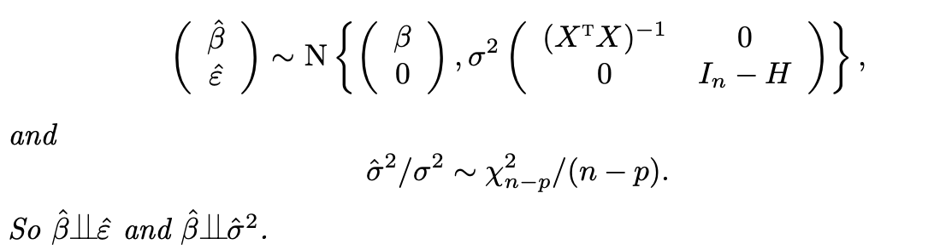

Statistical properties under Normal linear model
$Y=Xβ+ε$, $ε∼N(0,σ^{2}I)$ (fixed $x_{i}$)
Exact inference: scalar ($t$), vector ($F$)
Equivalence between Wald tests and F test (ANOVA)
Prediction: $E(y_{n+1})$ and $y_{n+1}$

Slide 7

Asymptotic inference
$Y=Xβ+ε$, $E\left(ε\right)=0$(fixed $x_{i}$)
$\hat{β}→β$ in probability
$\sqrt{n}\left(\hat{β}−β\right)→N(0, B^{−1}MB^{−1})$
EHW variance estimator
Asymptotic inference: scalar ($z$), vector ($χ^{2}$)
Prediction: $E(y_{n+1})$

Slide 8

Model fitting
Coefficient of determination: $R^{2}$
Equivalent definitions
Relationship between $R^{2}$ and the $F$ test
Interpretations and limitations

Slide 9
Model checking
Checking whether the assumptions hold
We check the assumptions indirectly through their implications
If the implications do not hold, then the assumptions may be implausible
Visual diagnostics: residual plot
Nonlinearity, heteroskedasticity
Leverage scores
Leave-one-out formula
Outlier detection

Slide 10
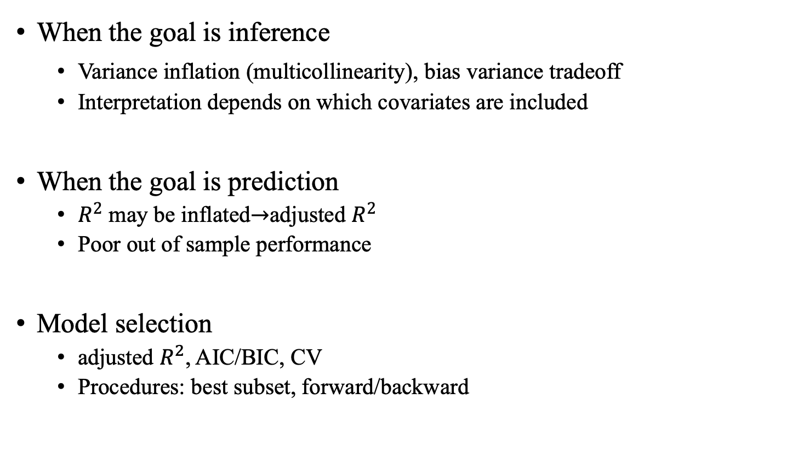
Overfitting
When the goal is inference
Variance inflation (multicollinearity), bias variance tradeoff
Interpretation depends on which covariates are included
When the goal is prediction
$R^{2}$ may be inflated$→$adjusted $R^{2}$
Poor out of sample performance
Model selection
adjusted $R^{2}$, AIC/BIC, CV
Procedures: best subset, forward/backward

Slide 11
Regularization
A systematic response to overfitting
Ridge regression
Lasso
For both approaches
Motivation
Optimization formulation
Computation
Tuning parameter selection

Slide 12
Generalized linear models
Binary outcomes
Categorical outcomes: nominal, ordinal
Count outcomes
For each scenario
Model formulation: GLM unification
Interpretation of the parameters
Computation: Newton’s method through irls
Inference: MLE
Prediction

Slide 13
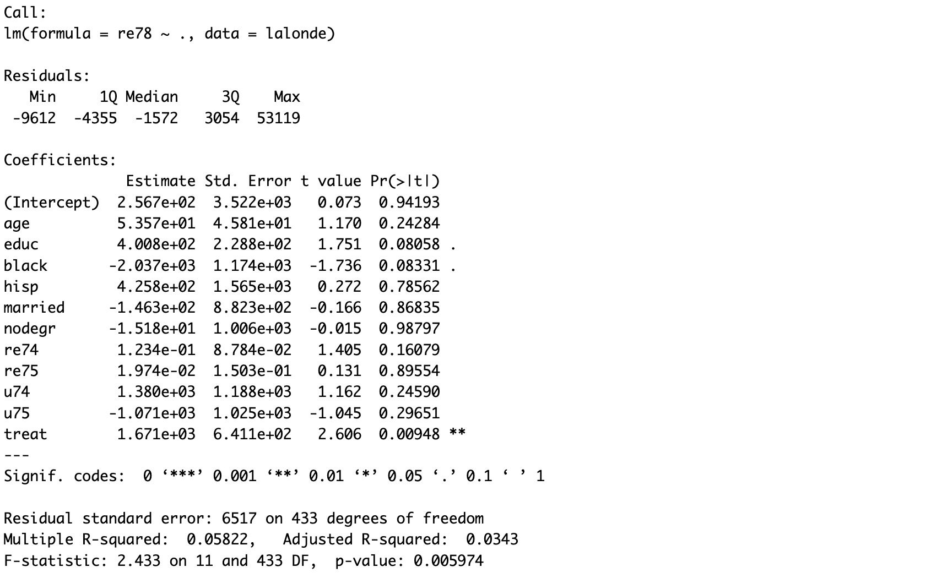
Understanding the code output
Summary of linear regression

Slide 14
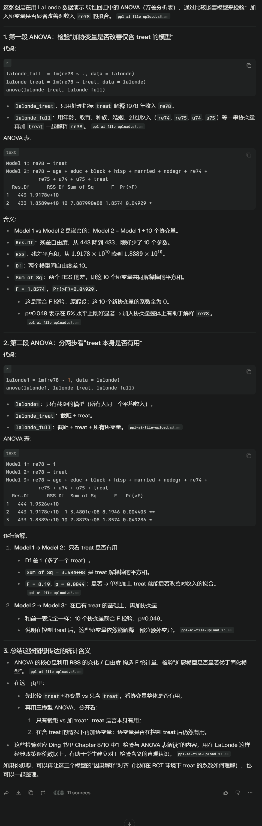
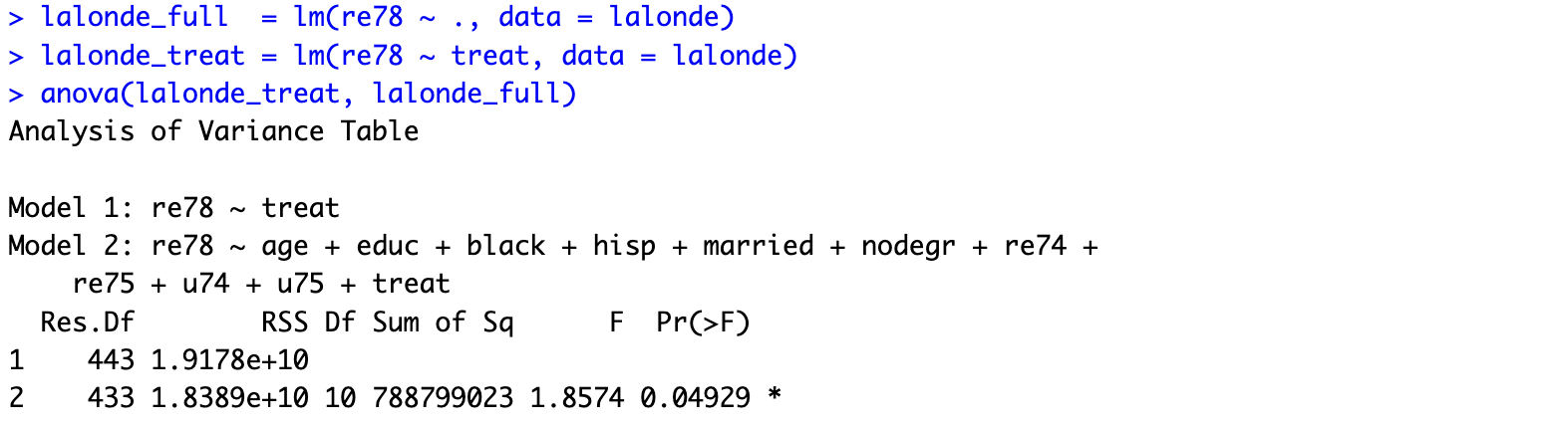
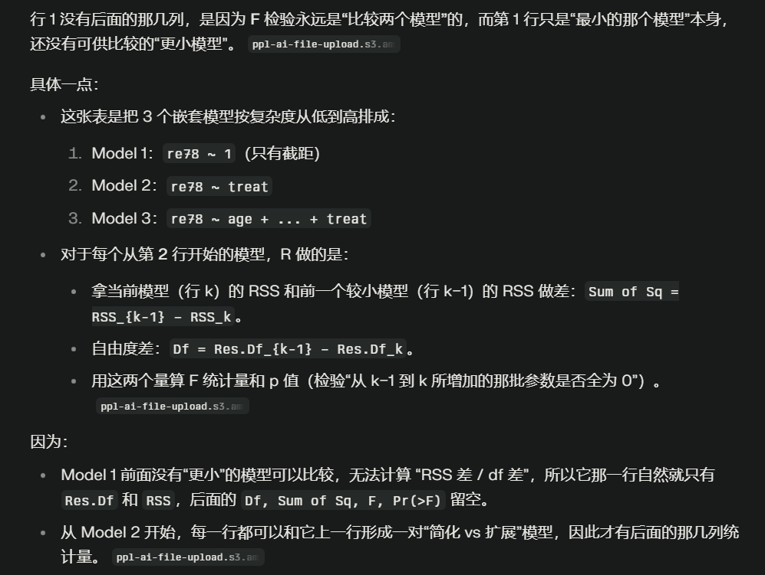
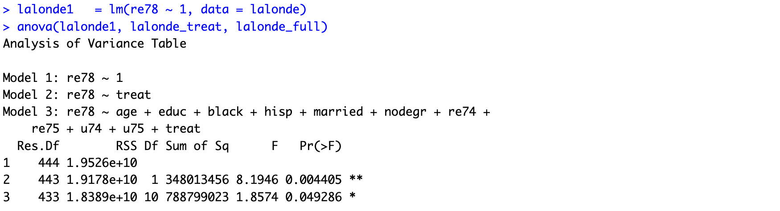
Understanding the code output
ANOVA

Slide 15
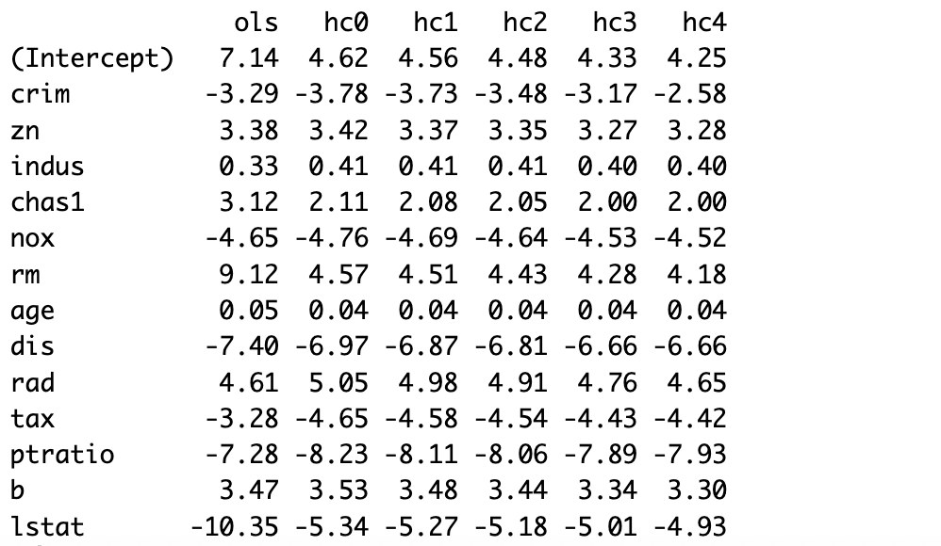
Understanding the code output
EHW variances

Slide 16
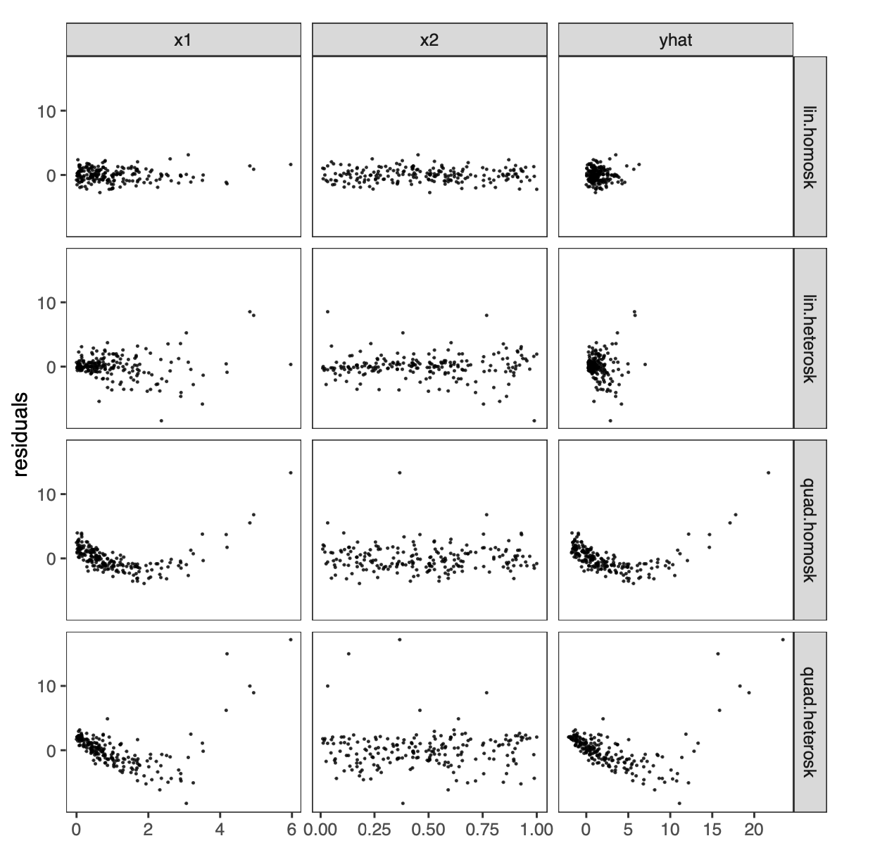
Understanding the code output
Residual plot

Slide 17
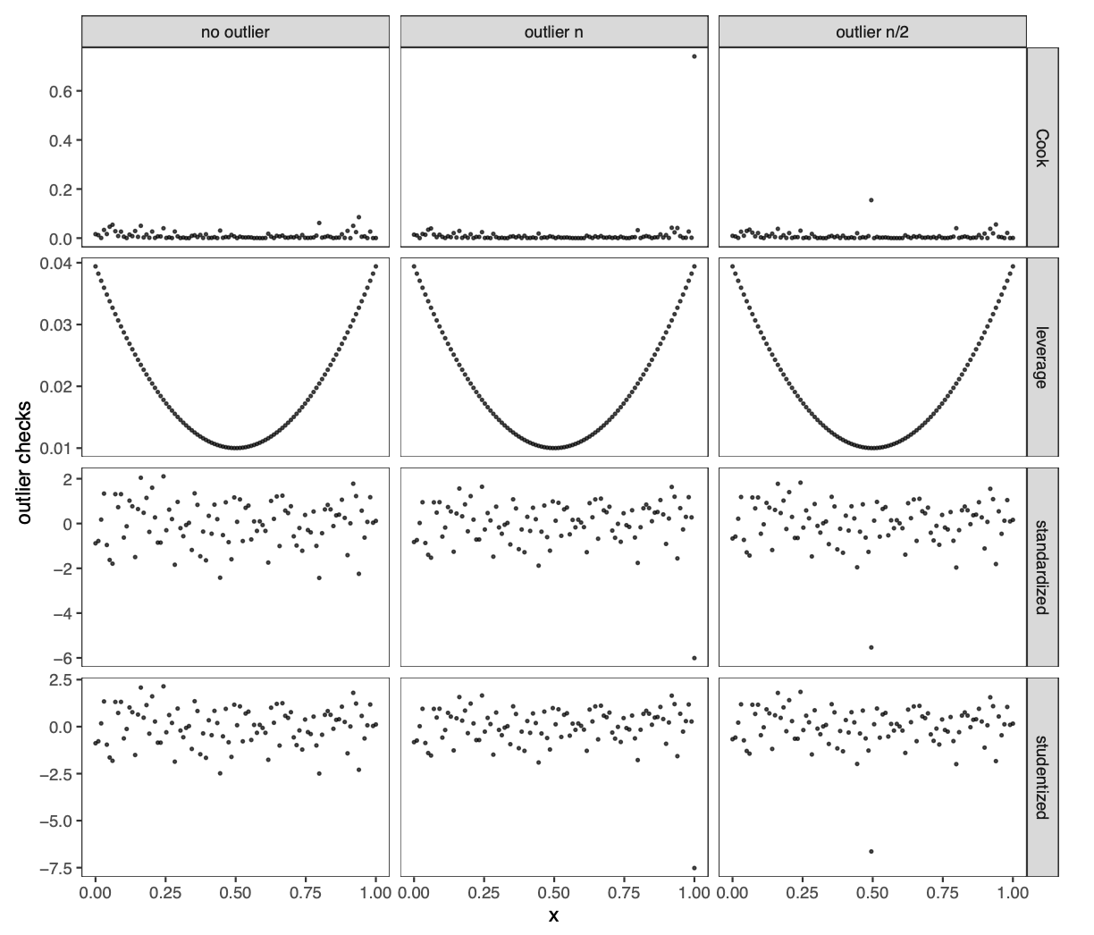
Understanding the code output
Outlier detection

Slide 18
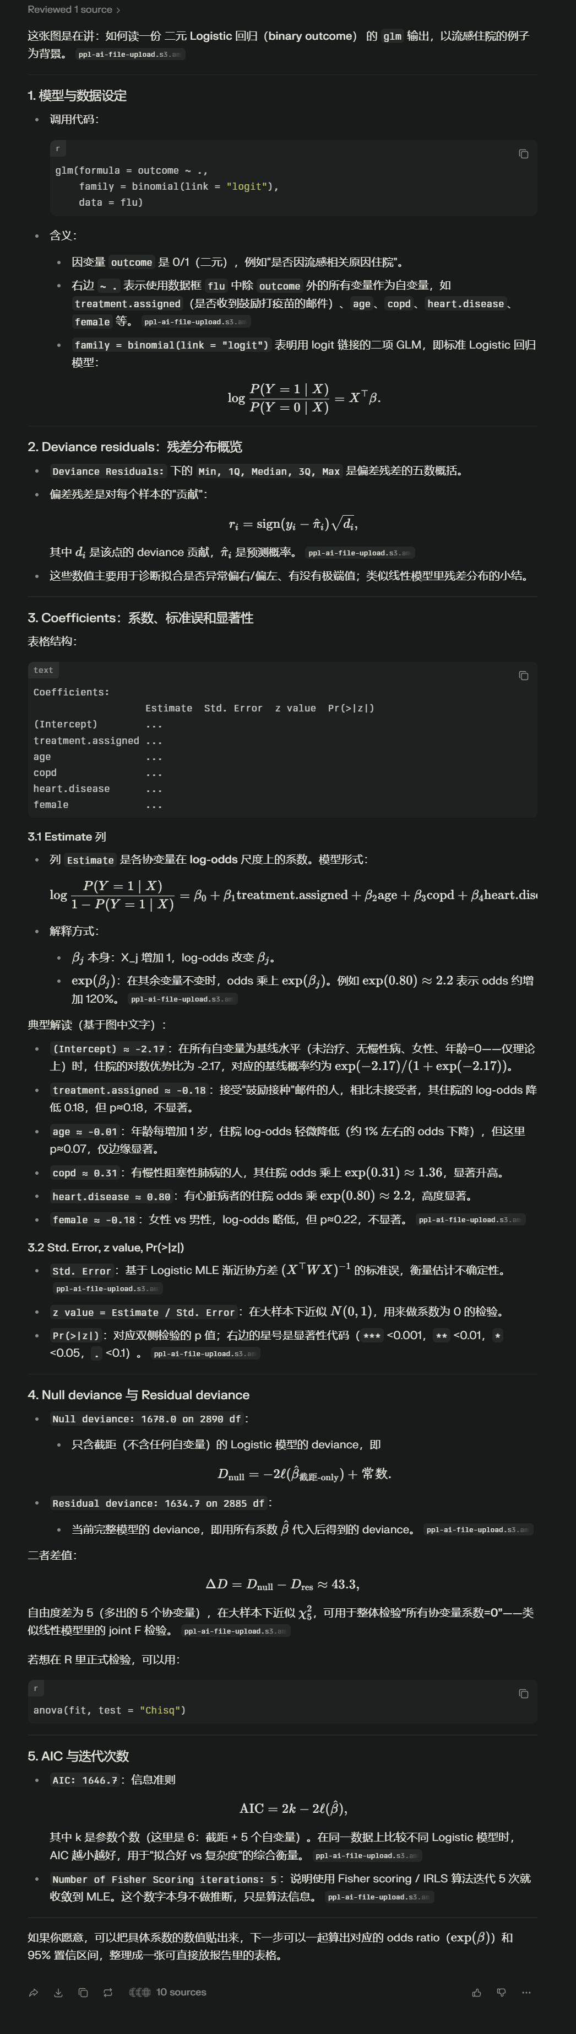
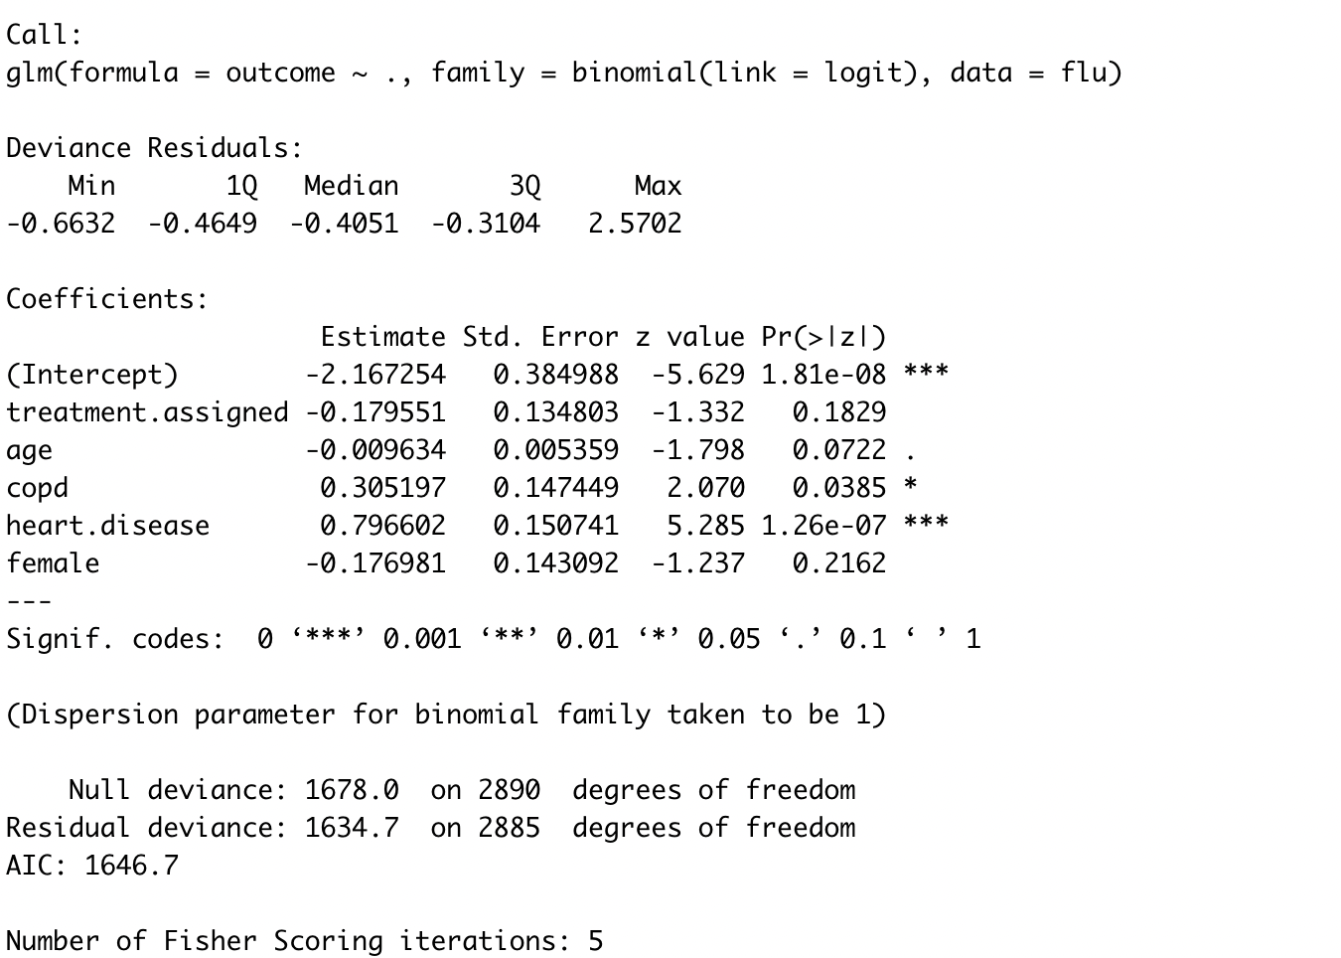
Understanding the code output
Logistic (binary outcome)

Slide 19
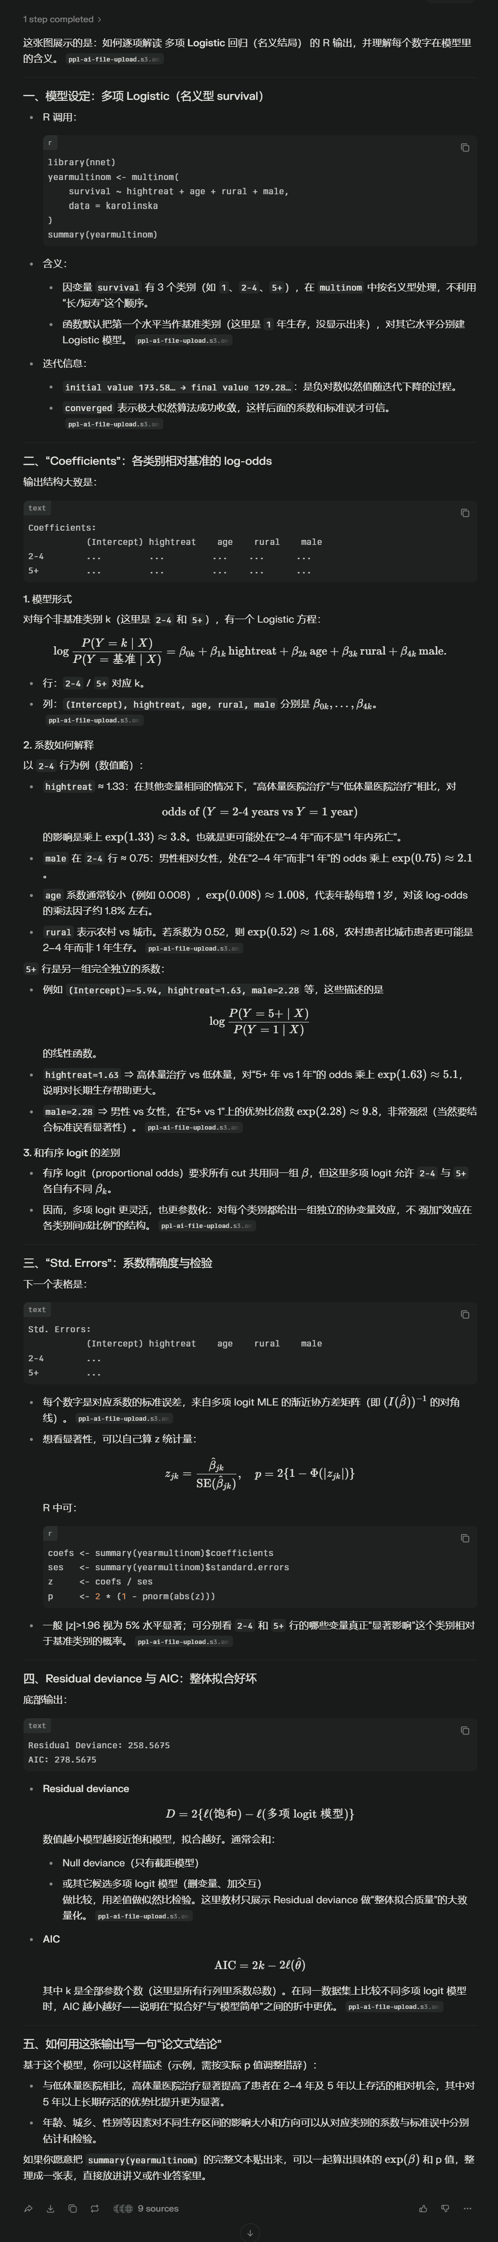
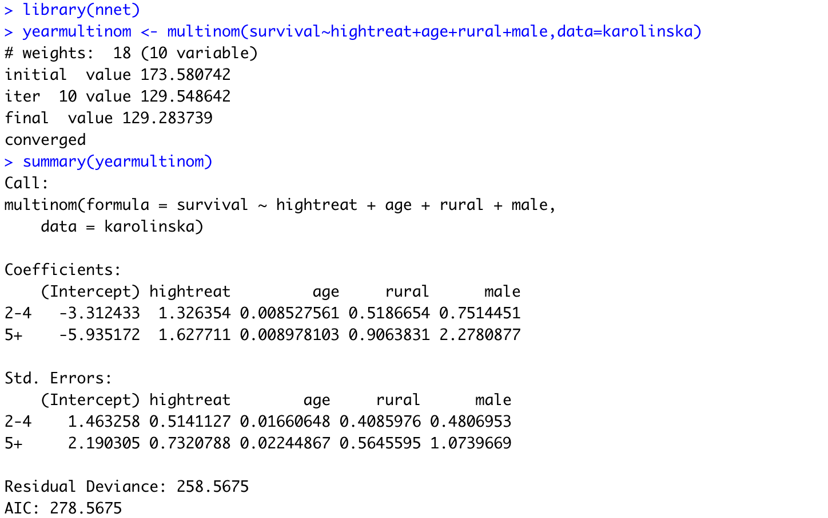
Understanding the code output
Logistic (nominal outcome)

Slide 20
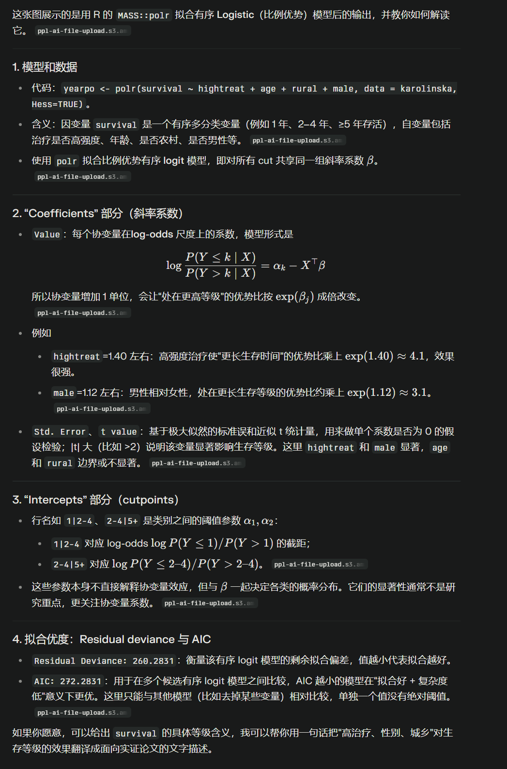
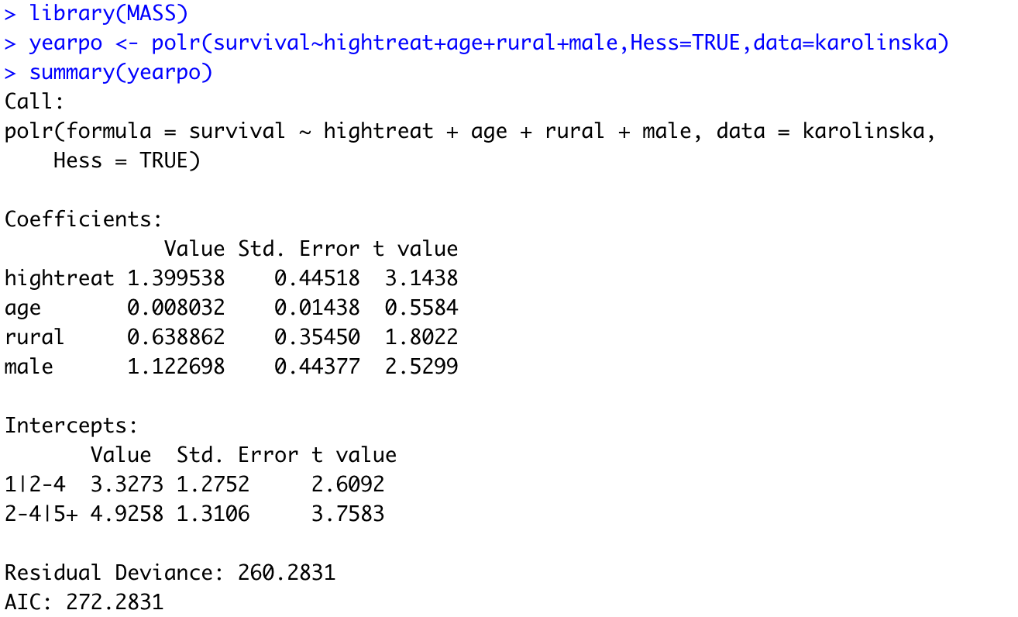
Understanding the code output
Logistic (ordinal outcome)

Slide 21
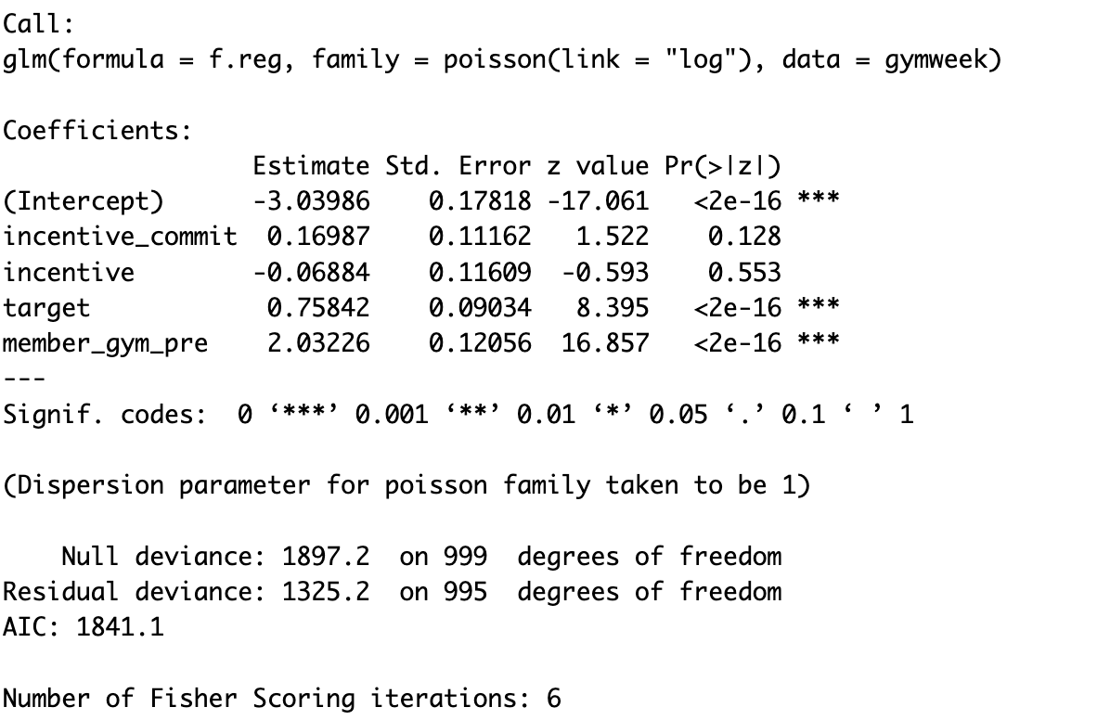
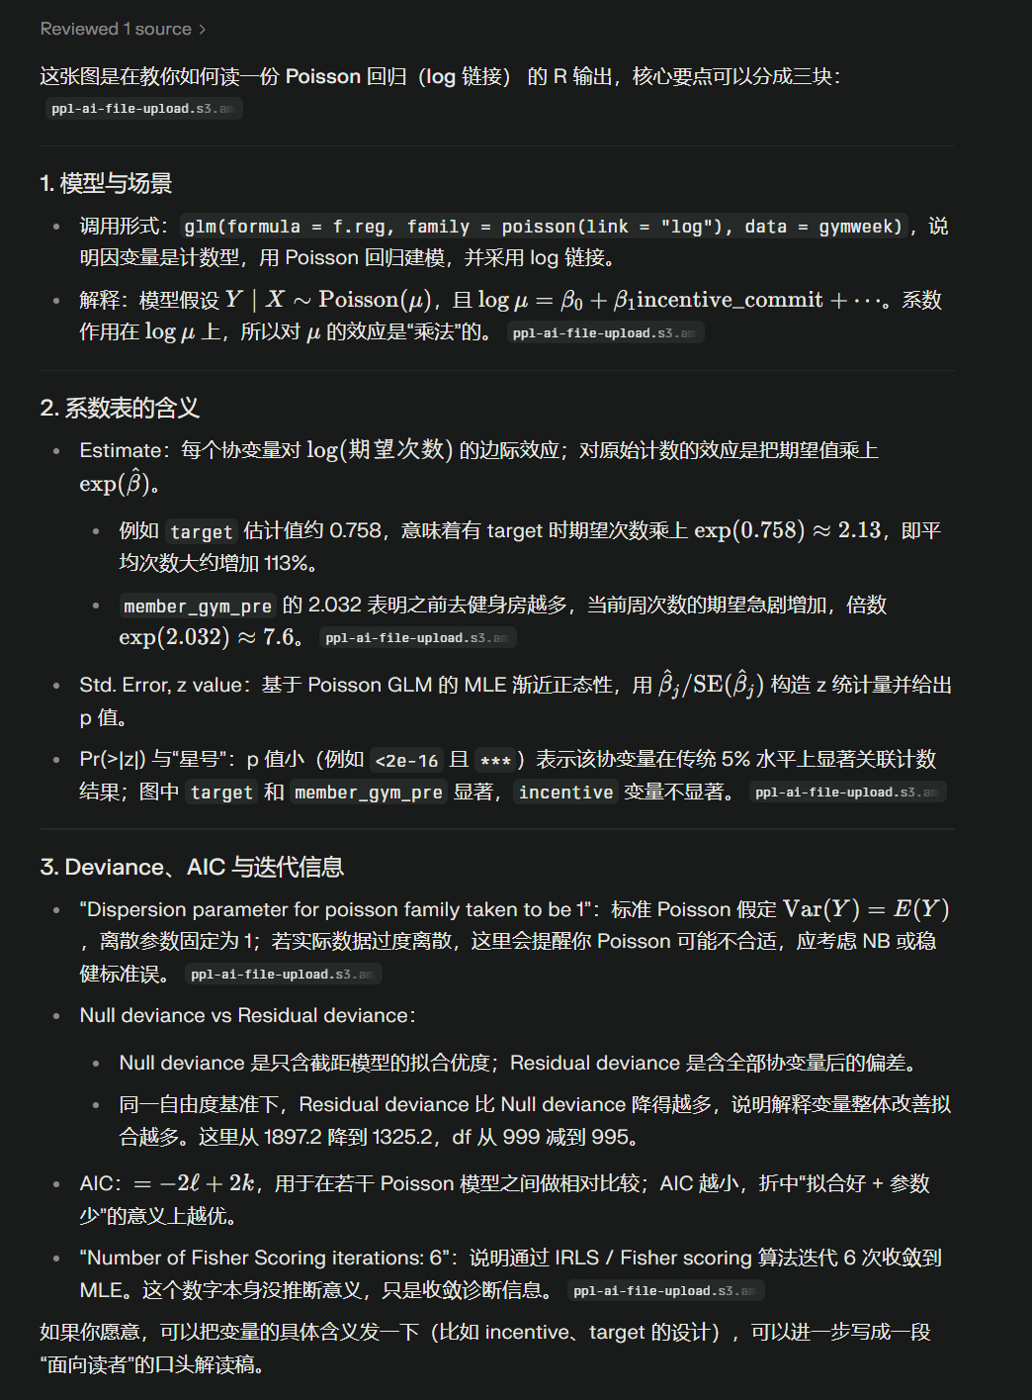
Understanding the code output
Poisson regression

Slide 22
What you are expected to understand
Technical details
Model formulation, estimation, inference, prediction, checking
Key computational ideas
Derivations of the asymptotic results are not required
Interpretation
Meaning of the assumptions
Choosing appropriate models for a given problem
Interpretation of parameters and fitted results
R implementation
Understand what the code is doing
Correct interpretation of the output

